Slide 1
Heterogeneity, Measurement Error, and Misallocation: Evidence from African Agriculture
Paper by D. Gollin; C. Udry
Presented by Joan Alegre.

Slide 2
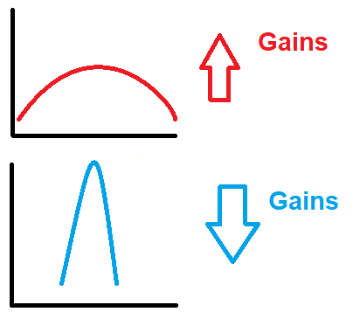
Higher variances on productivity lead to higher gains on reallocation.
Ln y
Ln y

Slide 3
Three main sources of variance apart from misallocation:
Idiosyncratic shocks over plots, i.e, floods, fire, weather. Over households, i.e, health, education…
Measurament errors on the data.
Heterogeneity on the quality of land.

Slide 4
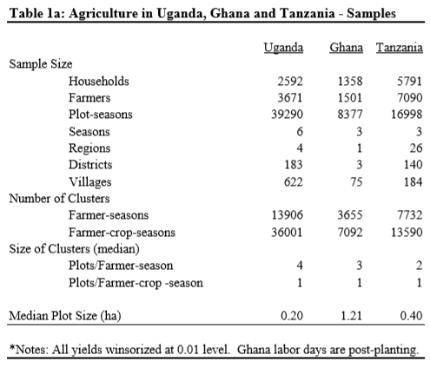
Descriptive Data.

Slide 5
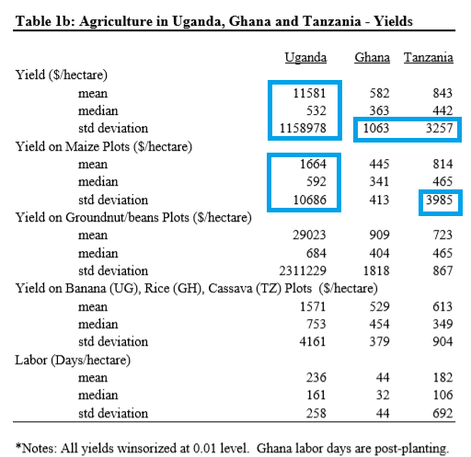
Tail with too much density

Slide 6
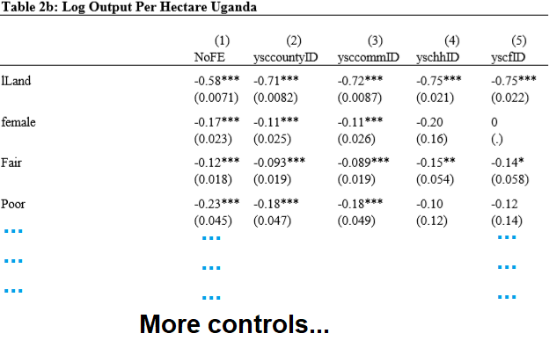
Distribution of the residuals of productivity of a plot.

Slide 7
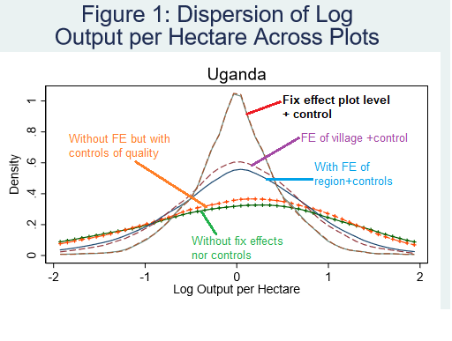
The more we control the lower is the variance of land productivity.

Slide 8

They estimate PFT from this production function
X is land quantity, L is labour
Blue part is the part atribuited to agent heterogeneity
Purple part are shocks that are unobserved to us but observed to the agent.
Yellow part is measurement error.
Green part, are shocks post chosing inputs.
Purple yellow and Green is what we aim to remove.

Slide 9
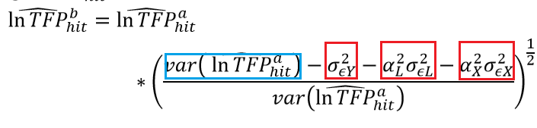
They find TFPb with this relationship
Red squares are elasticities of labour, output and land used with the level of measurament error

Slide 10
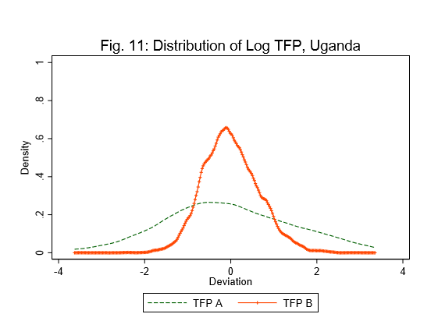
New variance is far much lower

Slide 11
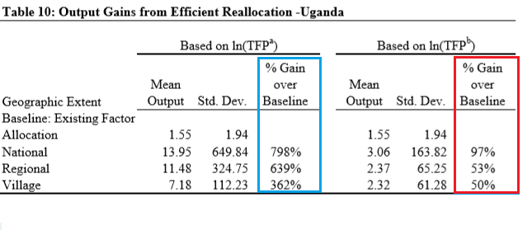
When variances are removed, then gain rates are much smaller

